Slide 1

Information for students with migratory biography - LYCEUMS

Slide 2
General Information
PROCEDURE
what’s NEXT

Slide 3
Students with migratory biography follow this programme in order to: ►learn Greek and ►get a grip/gain an understanding of how the public educational system in Cyprus works and adjust more smoothly into the school environment At the end of the first academic year, students take an exam in Greek. If they succeed in this exam, then they can either: ‘ ˃˃ take the necessary exams in order to join the section they like in class B’ Lyceum or ˃˃enter one of the sections for which no entry exams are needed.

Slide 4
No examination
No examination

Slide 5

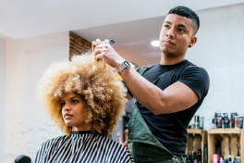
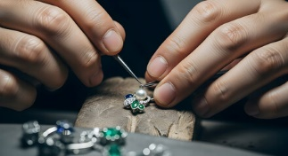
If they wish, they can transfer/enrol to a Technical/Vocational School where they can choose one of the many sections offered, such as Design, Hairdressing, Tourism, Hotel industry, Computer Technician, Jewellery Design, etc.
Info: https://www.moec.gov.cy/dmteek/en/index.html
The Apolytirion is equal to the Apolytirion obtained in a lyceum.

Slide 6
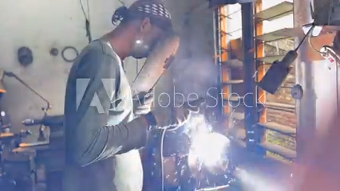
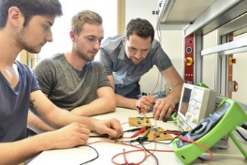


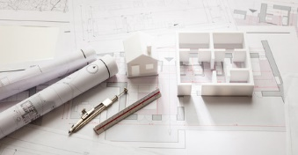

General Engineering, Architecture, Programming, Shipping, Chefs etc.
Info: https://www.moec.gov.cy/dmteek/en/index.html
The Apolytirion is equal to the Apolytirion obtained in a Lyceum.

Slide 7
Students with migrant background, who do not pass their examinations at the end of the first academic year, can continue attending the specific programme for only one more year, as long as they meet the age criteria (not above 18).
In case they do not meet the age criteria based on the legislation and have failed the examinations, they can join class B’ Lyceum, but they will not be awarded a leaving certificate.
♦A student can potentially be in this programme for only two years.

Slide 8

Further info:
Students with migrant background, who have failed the entry exams of the section they wish to follow for class B’, they can either join the 5th Section(Trade and Services) OR
The 6th Section (Art Section) of class B’ (year 2) with no entry exams
► They can also attend class B’ Lyceum not on a regular status of studies. Consequently, they will not be awarded an Apolytirion.
► A prerequisite again is for the student to meet the age criteria.
Students in class C/year 3 who succeed in obtaining their Apolytirion, can apply for a position at the public Universities of Cyprus with the Pancyprian exams in June, after their Apolytirion exams, in order to gain a BSc or BA degree.

Slide 9


***A STUDENT WHO WANTS TO OBTAIN THE APOLYTIRION, HE/SHE NEEDS TO STUDY ON A REGURAL STATUS OF STUDIES DURING CLASS B’ AND C’ OF LYCEUM OR TECHNICAL SCHOOL.

Slide 10
USEFUL WEBSITES:
► https://www.moec.gov.cy/
► https://enimerosi.moec.gov.cy/ypp19291
TRANSLATED DOCUMENTS:
►https://www.pi.ac.cy/pi/index.php?option=com_content&view=article&id=2466&Itemid=463&lang=el

Slide 11

Selection and compilation of material: Andri Mannouri, School Counselor Editing: Dr. Irene Rodosthenous, Head of the Career Counseling and Educational Services (CCES),
Eleni Papastefanou, Ιinspector of the Career Counseling and Educational Services (CCES)

